Slide 1
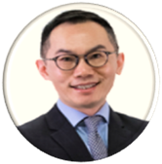
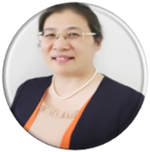
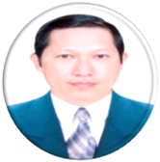
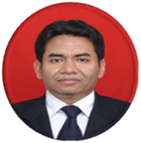
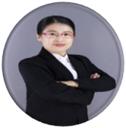
2019臺北醫學大學國際腦中風論壇 Taipei Medical University International Stroke Summit （TMUISS）April 26-27,2019
MOK Chung Tong,Vincent
(Hong Kong)
Topic:Cerebral Small Vessel Disease and Cognitive impairment
Yun Xu(China)
Topic:Precision Medicine in anti-platelet therapy for stroke
IguchiYasuyuki
(Japan)
Topic: cryptogenic stroke
LE Van Tuan(Vietnam)
Topic:post-stroke cognitive impairment at 3 months
Rusdy GhazaliMalueka,(Indonesia)
Topic:Prevalence of Stroke and the Associated Risk Factors in Yogyakarta,Indonesia
線上報名網址
Ke Han(China)
Topic:靜脈腦血流調控
TMUISS

